Slide 1
Distributed Key Value Store M.Eng. Project- Spring 2013 Project Advisor: Prof. Alan J. Demers
Team Members: Steeb Dsilva(smd323),
Harsh Panchal(hpp8),
Jayanth Parayil Kumarji(jp972),
Supriya Singh(ss2895)

Slide 2
Features
Virtual Clusters
Maintaining group membership in SimpleDB
Update propagation using Anti-Entropy
1-resilience

Slide 3


System architecture
Virtual clusters
SimpleDB
Channels
- Coordinator and
Memory Servers
- Coordinators
USER API:
PUT
GET
MS 1
MS 2
MS 2
MS 2
MS 1
MS 1
MS 3
MS 3
Coordinator 2
Coordinator 3
Coordinator 1
MS 4
Internet
SimpleDB
HTTP request
Anti-Entropy connection
GET-PUT connections
Client

Slide 4
SimpleDB
SimpleDB structure
address: The field would contain the IP address of the coordinator and a timestamp as the cluster initializes.
The default value of this field is ‘NONE’
list: This field would be used to maintain the group membership and contains the list of all the coordinator IP addresses present in system.
Virtual Data Clusters
Check presence of coordinatorIP in simpleDB
Coordinator: writes itself in simpleDB, waits for memory servers
Memory server : connects to coordinatorIP
itemName() | address | list
Coordinator

Slide 5
Group membership
SimpleDB maintains membership list
Coordinator maintains local member list
Regular intervals the coordinator and SimpleDB synchronizes their member list
PUTS on SimpleDB conditional

Slide 6
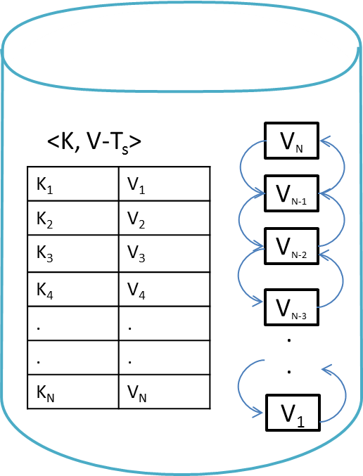
Key Value Store
Checksum
HashMap
Doubly Linked List
Anti-entropy Pointer
Anti-entropy status bit

Slide 7
PUT Requests
Coordinator assigns timestamp
Computes checksum of the key
Checksum at coordinator recomputed
Memory server selected by hashing keys
- lock TCP and send data
At memory server add data in hashmap
Unlock TCP and sent to write on backup.

Slide 8
Anti-Entropy
Check the anti-entropy status of own cluster
If AntiEntropy status not set, set AntiEntropy status , set memory server status.
Performs AntiEntropy till checksums match

Slide 9
Test
Volume of PUT
No of Keys | Time (ms)
10 | 883.418
100 | 8651.549
1000 | 84701.132
10000 | 834243.698

Slide 10
Anti-Entropy Time duration:
No of Keys | Initiator cluster: Time(ms) | Contributor cluster: Time(ms)
0 | 540 | 262
10 | 3674 | 3586
100 | 33321 | 33190
500 | 172895 | 172798
1000 | 388450 | 388327
2000 | 776604 | 776467
5000 | 1887492 | 1887351
10000 | 3851465 | 3581600

Slide 11
Thank You !

